Slide 1
In Silico Comparison of Photons versus Carbon Ions in Single Fraction Therapy of Lung Cancer
Kristjan Anderle

Slide 2
Outline
Introduction
Normal Lung Cancer Patients
Multiple Tumors Lung Cancer Patients
Conclusion & Outlook

Slide 3
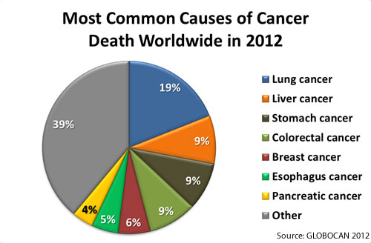
Introduction

Slide 4
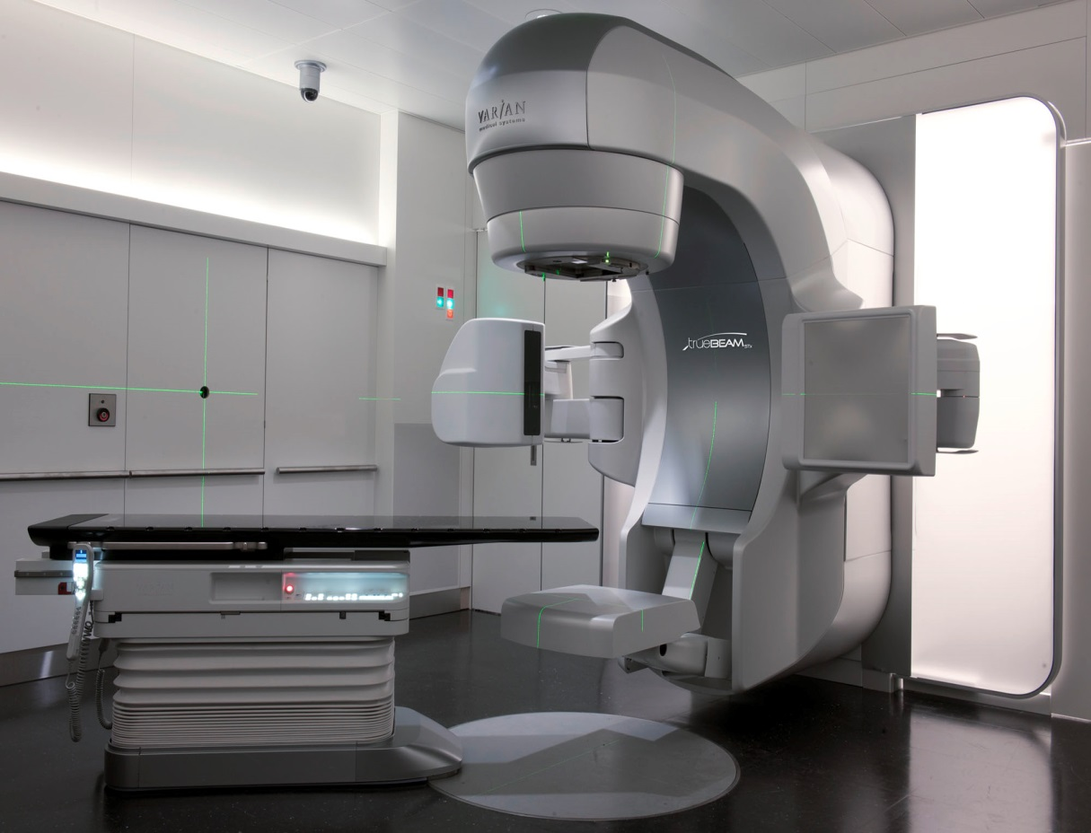
Stereotactic Body Radiation Treatment (SBRT)

Slide 5
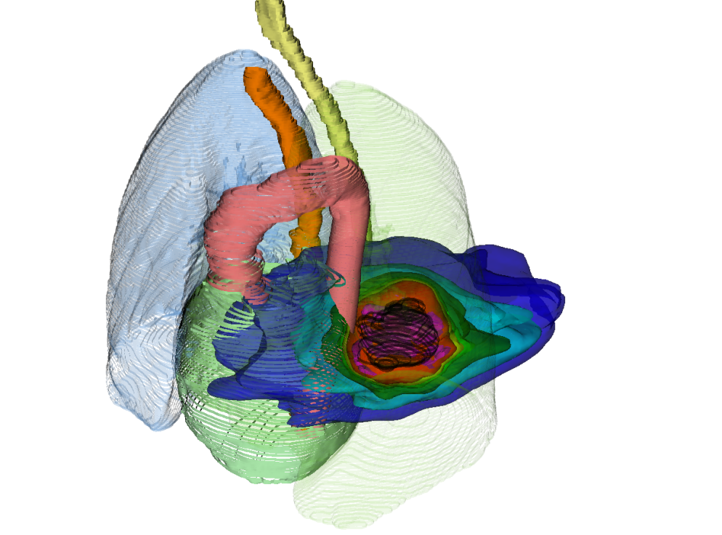
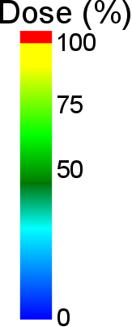
SBRT
SBRT

Slide 6
SBRT
photons
12C
photons
p+

Slide 7
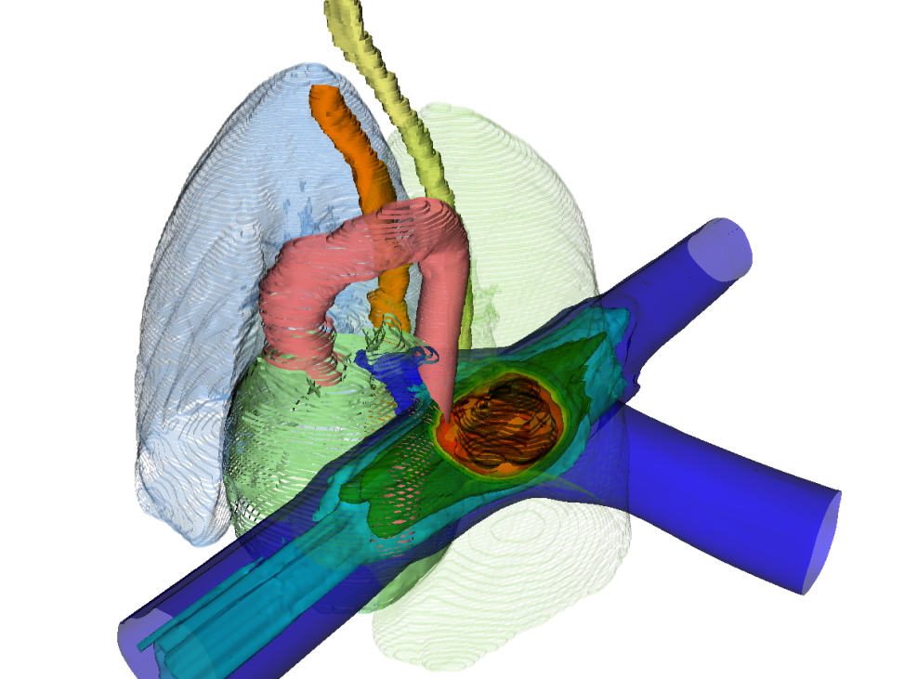
SBRT vs PT
photons
¹²C
12C
photons
p+

Slide 8
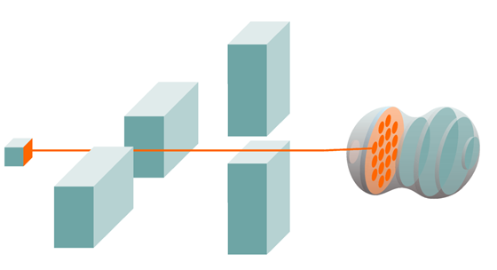
Active Scanning with ¹²C (PT)

Slide 9
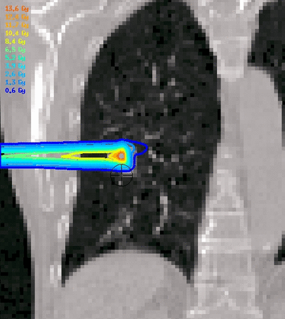
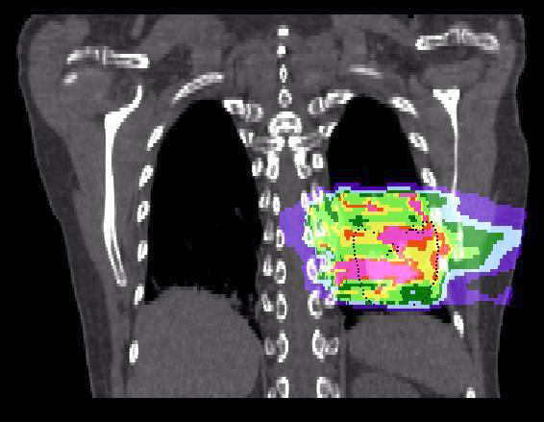
Motion effects
Courtesy M. Söhn, LMU
Courtesy C. Graeff, GSI

Slide 10
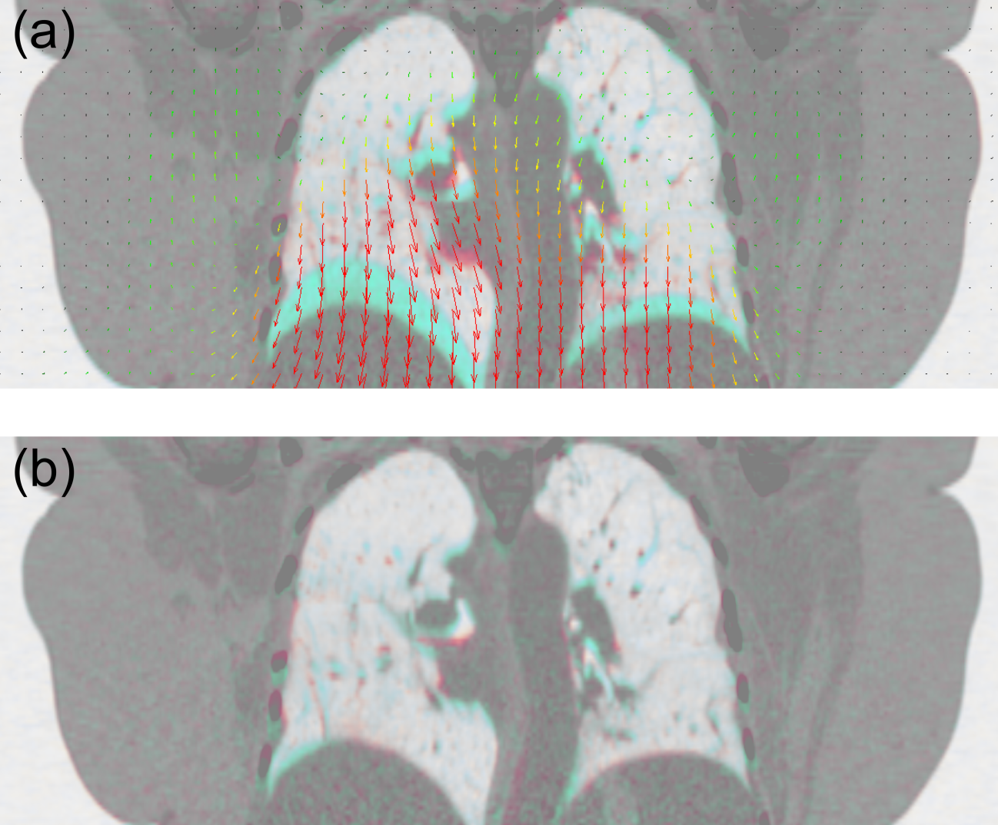
Deformable Image Registration & Quality Assurance
Before registration:
After registration:

Slide 11
Outline
Introduction
Normal Lung Cancer Patients
Multiple Tumors Lung Cancer Patients
Conclusion & Outlook

Slide 12
Patient Data
19 patients, 26 tumors
Average tumor volume: 2.9 cm³
Average tumor motion: 3.1 mm

Slide 13
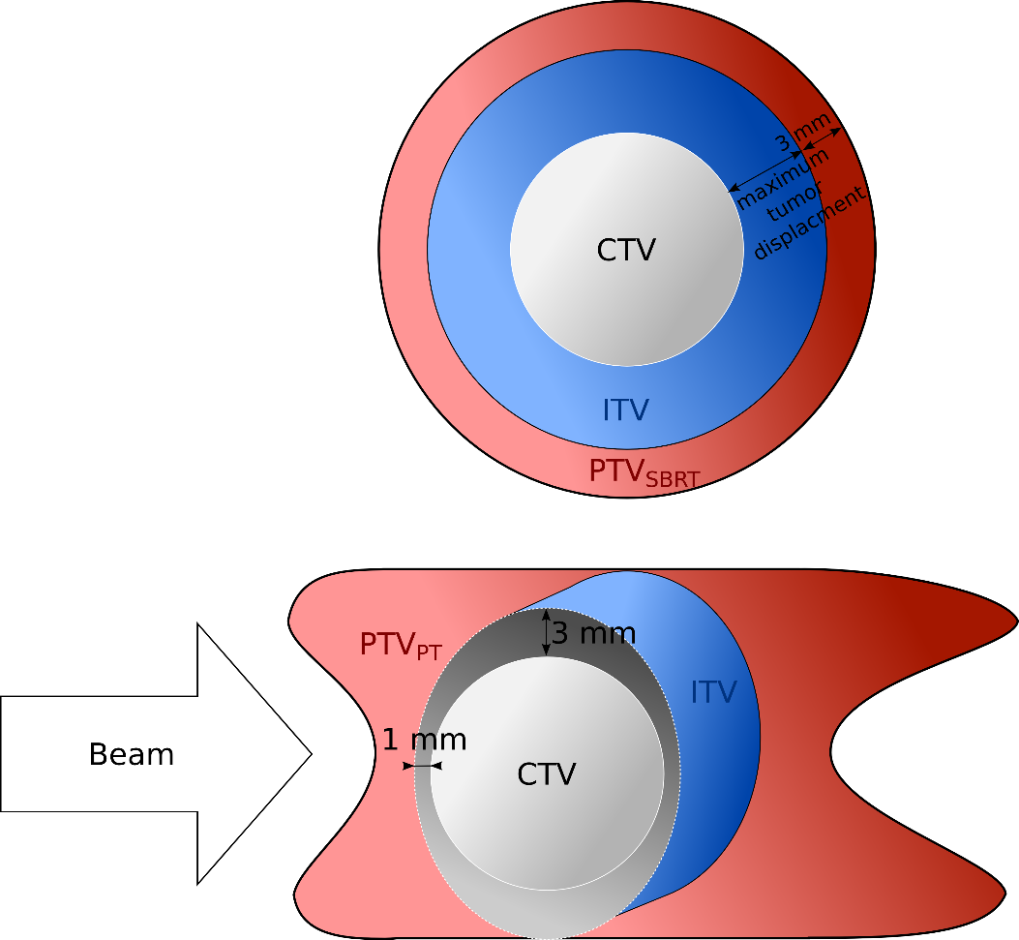
Patient Data – Normal Cases
19 patients, 26 tumors (each tumor 1 x 24 Gy)
Average tumor volume: 2.9 cm³
Average tumor motion: 3.1 mm
Single field uniform optimization
LEM IV biological model

Slide 14
Patient Data – Normal Cases
SBRT single treatment plan
PT 10 dose calculations per patient:
Without motion, static (2x)
With motion, without compensation, 4D-interplay (4x)
With motion, with compensation, 4D-rescanning (4x)

Slide 15
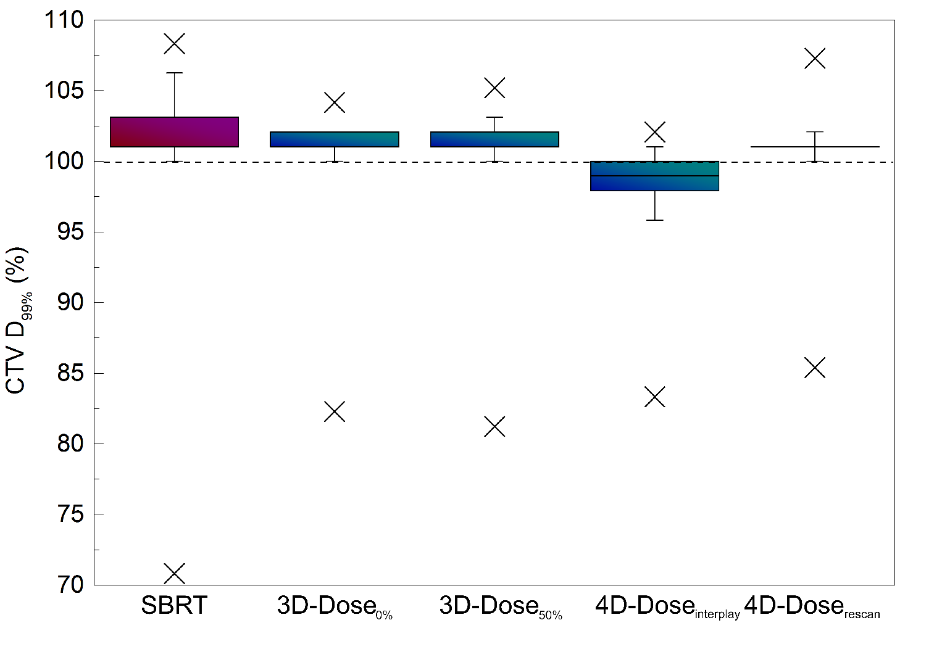
Normal cases – Dose to Tumors

Slide 16
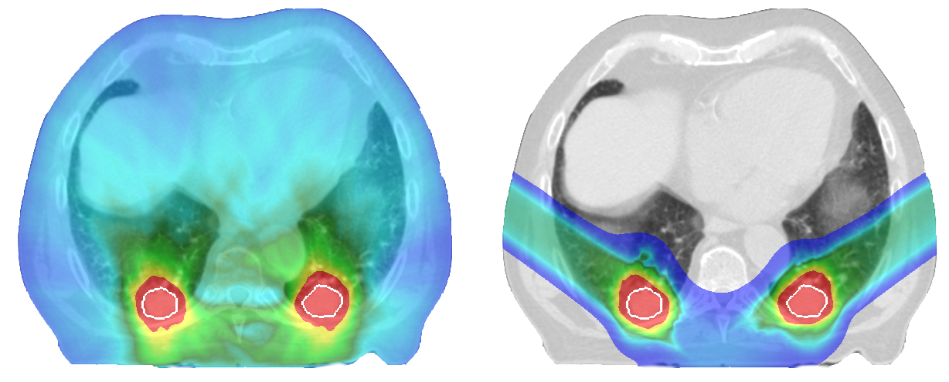
Normal Cases - Example
SBRT
PT

Slide 17
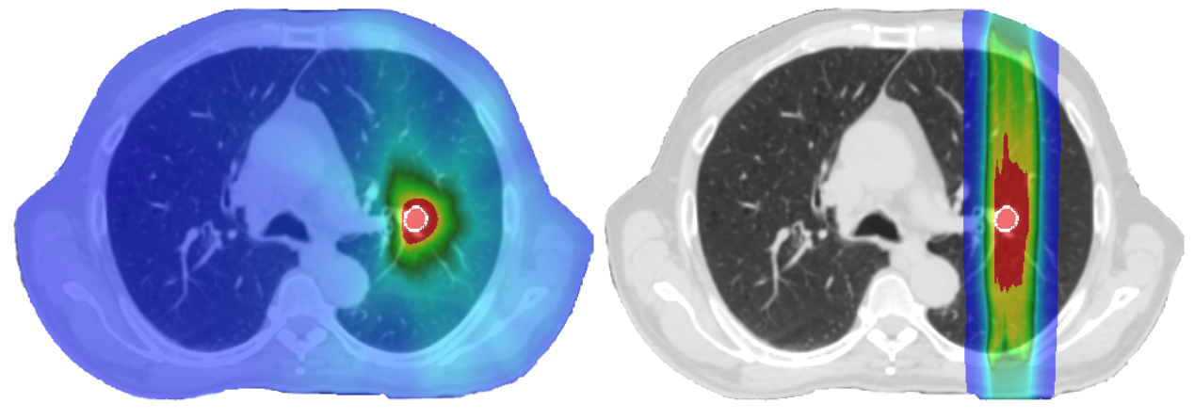
Normal Cases - Example
SBRT
PT

Slide 18
Normal Cases- Dose to Critical Organs

Slide 19
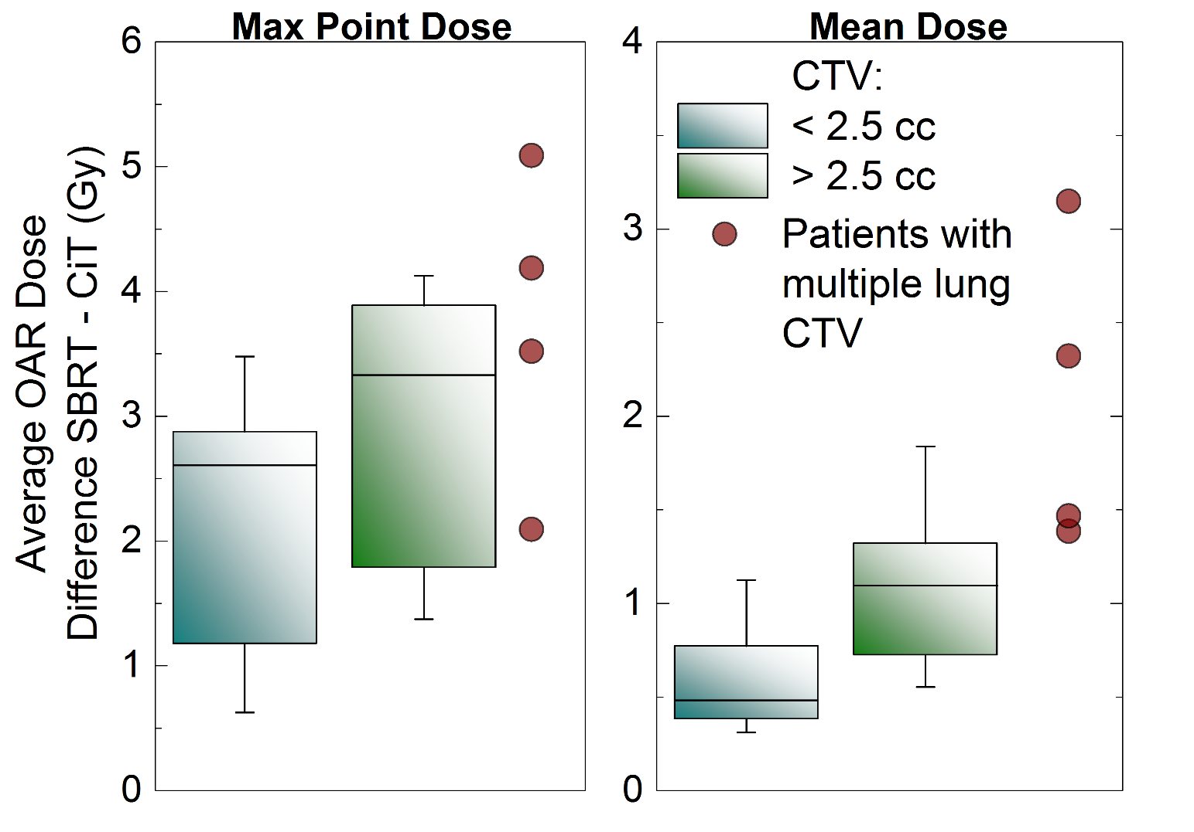
Normal Cases- Dose to Critical Organs

Slide 20
Outline
Introduction
Normal Lung Cancer Patients
Multiple Tumors Lung Cancer Patients
Conclusion & Outlook

Slide 21
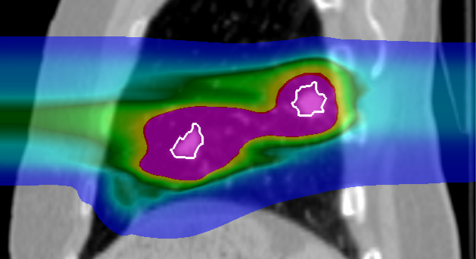
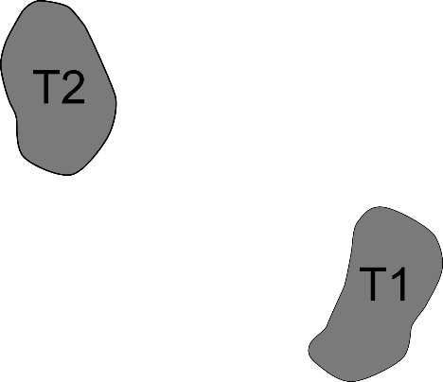
Intensity modulated particle therapy optimization for multiple targets

Slide 22
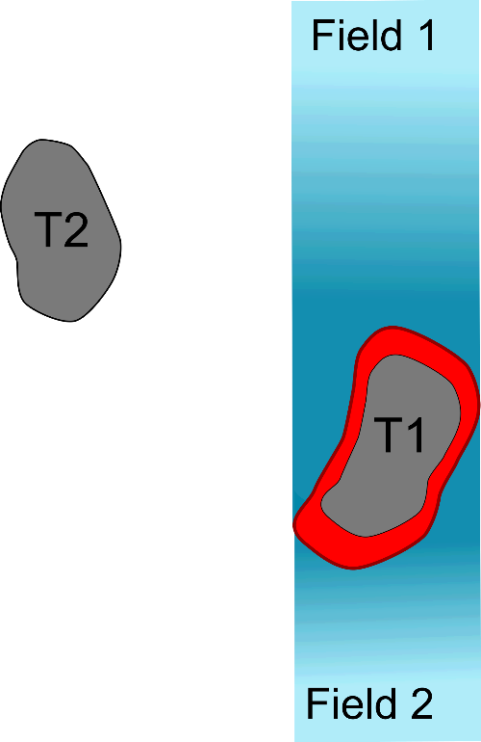
Intensity modulated particle therapy optimization for multiple targets

Slide 23
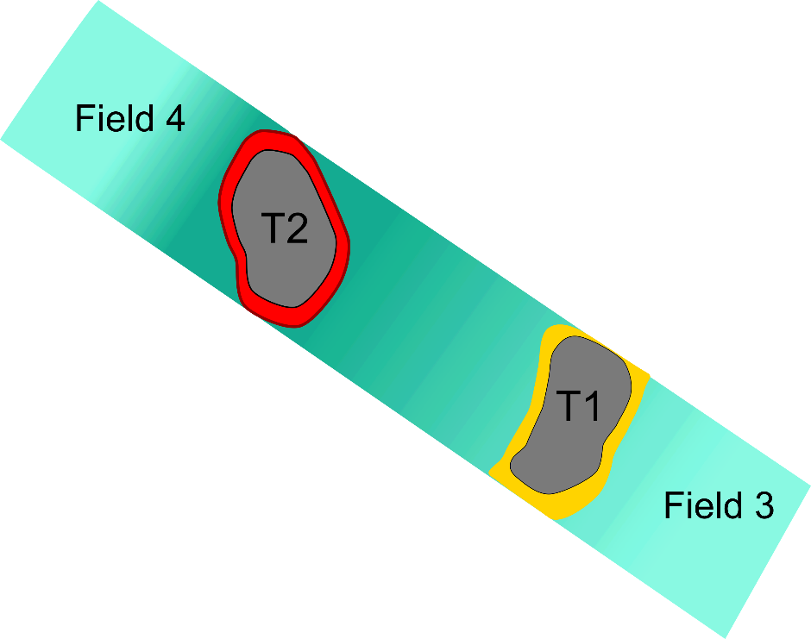
Intensity modulated particle therapy optimization for multiple targets

Slide 24
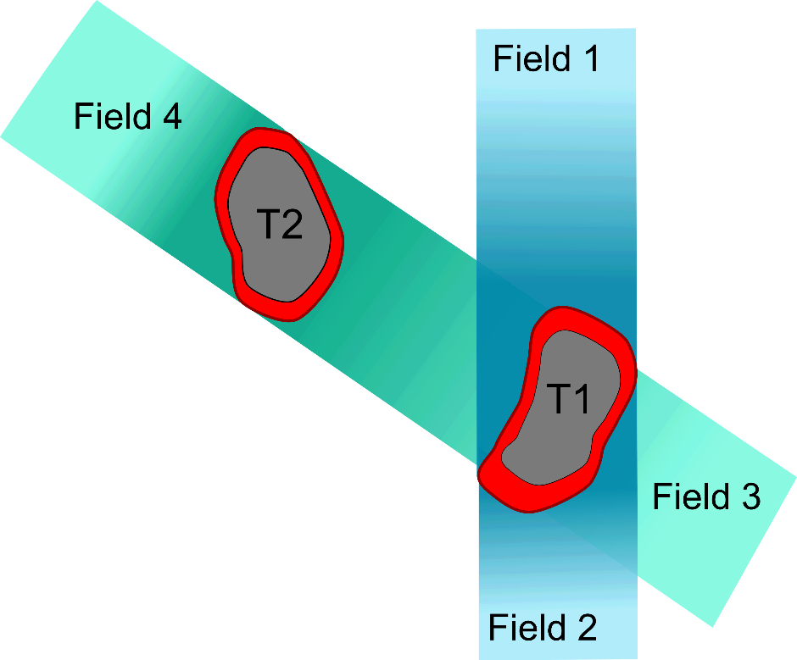
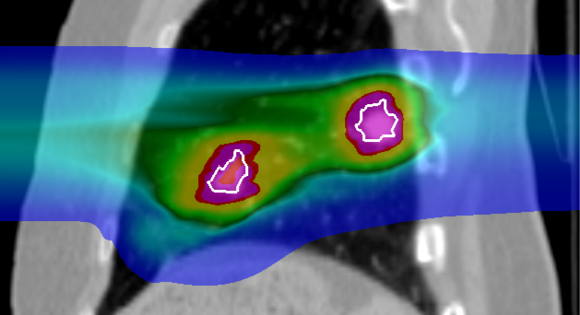
Intensity modulated particle therapy optimization for multiple targets

Slide 25
Patient Data – Multiple Tumors
8 patients, 24 tumors
Average tumor volume: 4.1 cm³
Average tumor motion: 5.9 mm
Several critical organs in close vicinity to the tumor

Slide 26
Patient Data – Multiple Tumors
SBRT single treatment plan
PT 8 dose calculation per patient:
2 optimizations, each 4 breathing patterns
Dose escalation for 3 patients to 1 x 24Gy

Slide 27
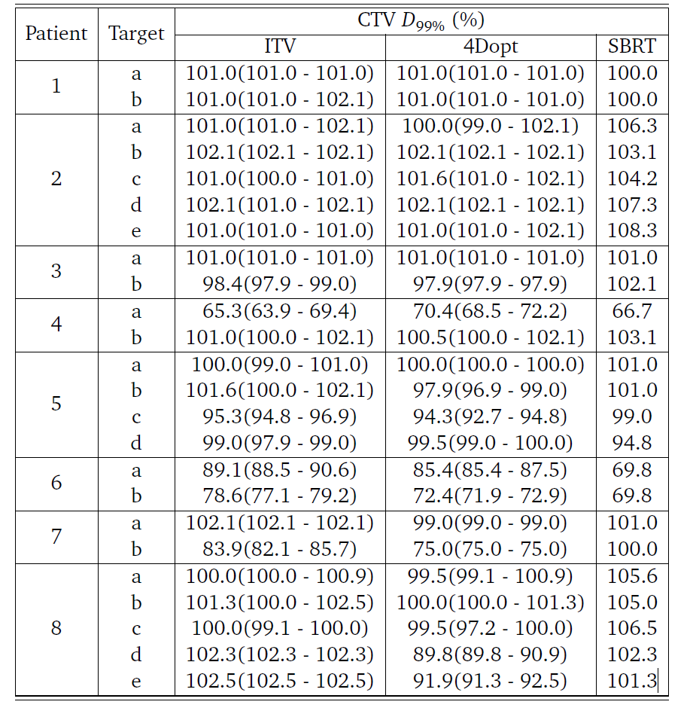
Multiple Tumors – Dose to the Tumors

Slide 28
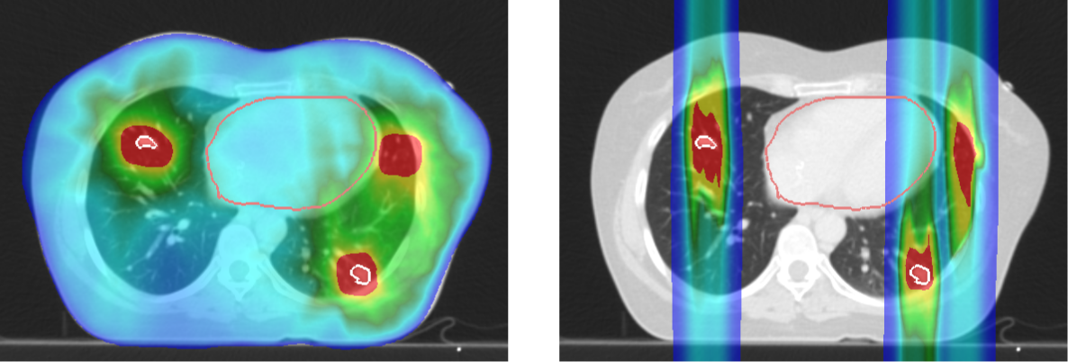
Multiple Tumors - Example
SBRT
PT

Slide 29
Multiple Tumors – Dose to the Tumors

Slide 30
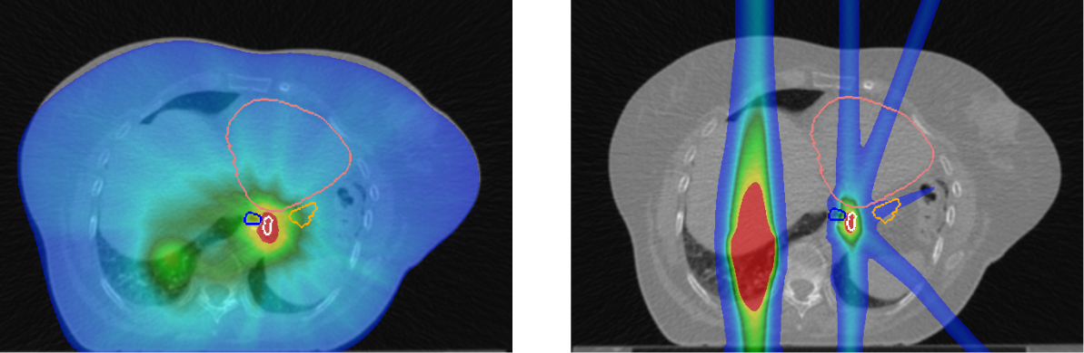
Multiple Tumors - Example
Heart
Heart
Esophagus
Stomach
Esophagus
Stomach
Target
Target
SBRT
PT

Slide 31
Multiple Tumors – Dose to Critical Organs

Slide 32
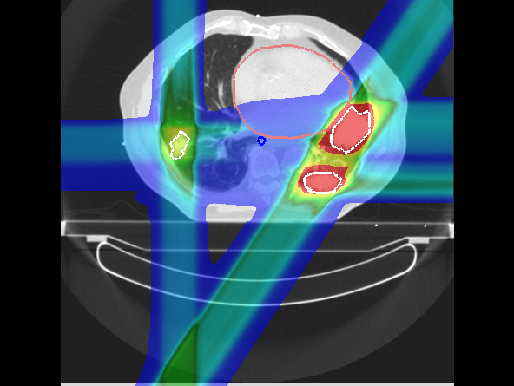
Complex Cases – dose escalation

Slide 33
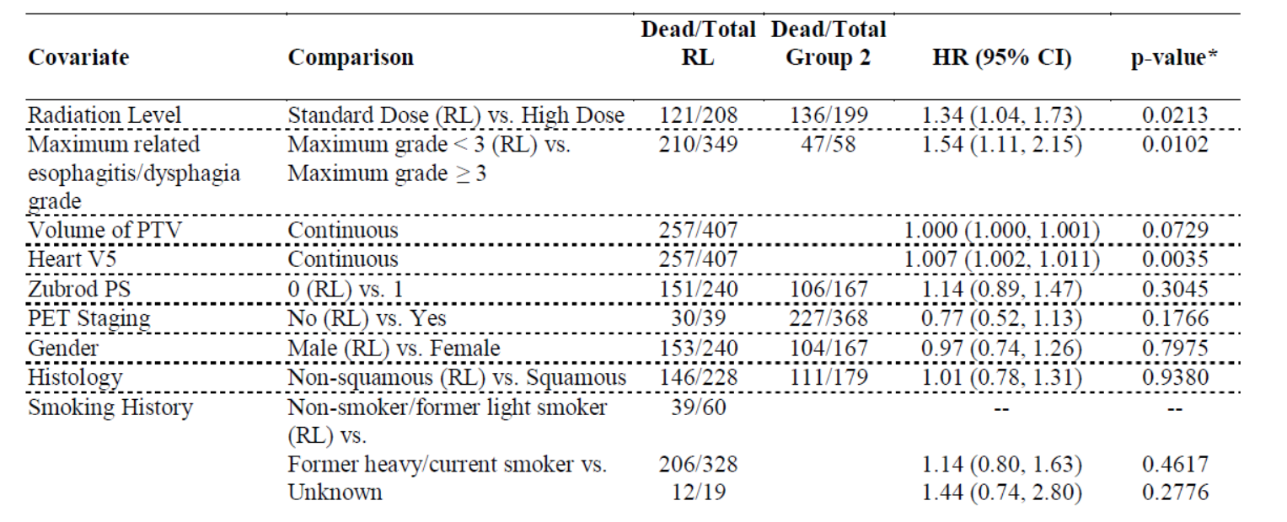
Clinical Trial RTOG 0617

Slide 34
Clinical Trial RTOG 0617

Slide 35
Clinical Trial RTOG 0617

Slide 36
Clinical Trial RTOG 0617

Slide 37
Outline
Introduction
Normal Lung Cancer Patients
Multiple Tumors Lung Cancer Patients
Conclusion & Outlook

Slide 38
Conclusions
PT delivers the same dose to tumors as SBRT,
while depositing significantely less dose to normal tissue.
PT could deliver full ablative dose in single fraction, where SBRT could not
PT should be considered as a treamtent modality for lung cancer patients

Slide 39
Outlook
Phase III Randomized Trial Comparing Overall Survival After Photon Versus Proton Chemoradiotherapy for Inoperable Stage II-IIIB NSCLC (RTOG 1308), started in 2014, passive scattering proton therapy
First lung cancer patients treated with active scanning carbon-ions at NIRS, Chiba (Japan)
Löwe?

Slide 40

Acknowledgments
GSI
C. Graeff
M. Durante
A. Eichorn
M. Prall
S. Hild
FC
J. Stroom
C. Greco
N. Pimentel
S. Vierra
UK Erlangen
C. Bert
T. Brandt
J. Wölfelschneider

Slide 41
Thank you for your attention.

